Slide 1
Detector Physics
Semiconductor Detectors
GAPS Postdoc Lecture Series – November 2, 2015
D. Lascar | Postdoctoral Fellow | TRIUMF

Slide 2
Outline
Semiconductor refresher
Doping
Junctions
Detectors
Si and Si(Li)s
HPGes
Notes:
Solid materials offer a great advantage over gas. Densities 1,000 times greater than gas.
More interactions
More primary information carriers
In gas ionization detectors the information carriers are electron-ion pairs. What are the primary information carriers in semiconductor detector?

Slide 3
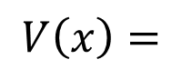
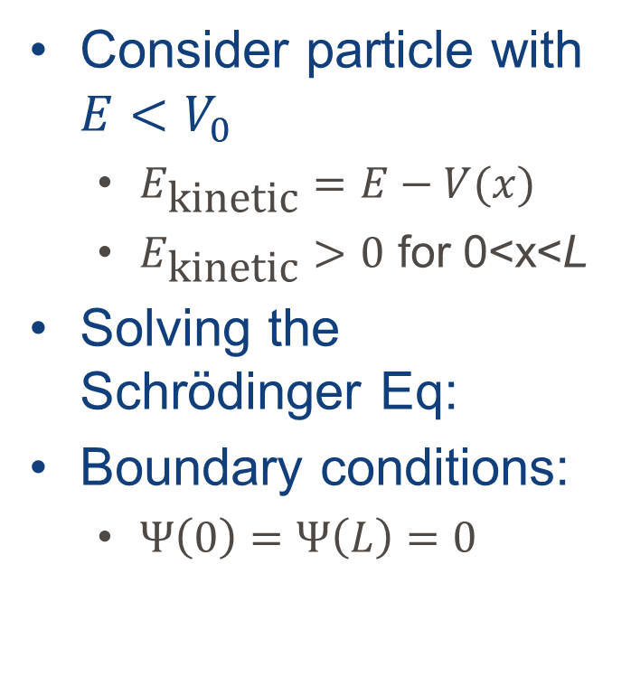
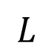
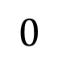
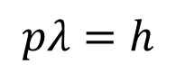
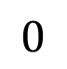
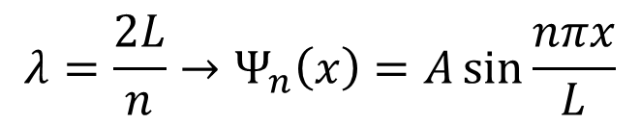
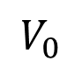
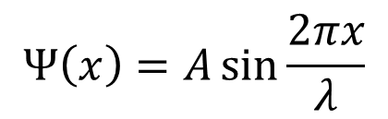
Particle in a finite potential well
$$pλ=h$$
$$V_{0}$$
Consider particle with $E<V_{0}$
$E_{\text{kinetic}}=E−V(x)$
$E_{\text{kinetic}}>0$ for 0<x<L
Solving the Schrödinger Eq:
Boundary conditions:
$Ψ\left(0\right)=Ψ\left(L\right)=0$
$$V\left(x\right)=$$
$$0$$
$$0$$
$$L$$
$$Ψ\left(x\right)=A\sin{\frac{2πx}{λ}}$$
$$λ=\frac{2L}{n}→Ψ_{n}\left(x\right)=A\sin{\frac{nπx}{L}}$$
Notes:
The simple approximation for a bound electron is a 1-dimensional well of potential energy $V(x)$ with width L and depth V₀.
If we’re really being pedantic then there’s a constant at the end of the wave function.

Slide 4
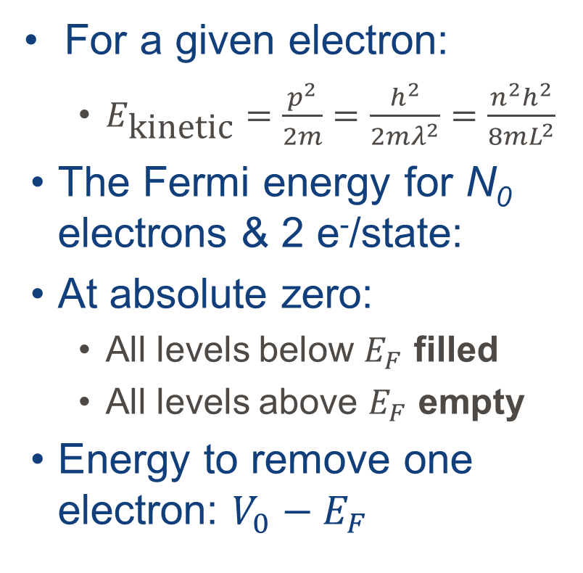
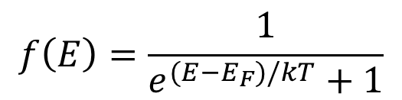
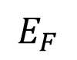
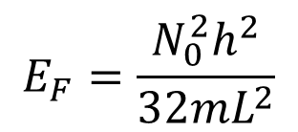
Many electrons in the well
$$pλ=h$$
Empty States
$$V_{0}$$
For a given electron:
$E_{\text{kinetic}}=\frac{p^{2}}{2m}=\frac{h^{2}}{2mλ^{2}}=\frac{n^{2}h^{2}}{8mL^{2}}$
The Fermi energy for N₀ electrons & 2 e⁻/state:
At absolute zero:
All levels below $E_{F}$ filled
All levels above $E_{F}$ empty
Energy to remove one electron: $V_{0}−E_{F}$
$$E_{F}$$
Filled States
$$0$$
$$0$$
$$L$$
$$E_{F}=\frac{N_{0}^{2}h^{2}}{32mL^{2}}$$
$$f\left(E\right)=\frac{1}{e^{(E−E_{F})/kT}+1}$$

Slide 5
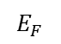
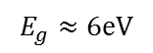
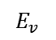
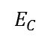
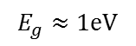
Crystals
E-levels of atoms form closely spaced levels called “bands”
Energy level spacing creates “band gaps”
Conduction band
Band
gap
$$E_{F}$$
Conduction band
$$E_{C}$$
Electron energy
$$E_{g}≈\text{1}\text{eV}$$
$$E_{g}≈6\text{eV}$$
Valence
band
$$E_{v}$$
Valence band
Insulator
Semiconductor
Metal
Notes:
Band gap > 1 eV – insulator.
Band gap ≤ 0eV – metal→highest occupied band nor full so electrons can move
Band gap ≤ 1 eV – semiconductor.
“Conduction band” is the name given to the first empty band if no thermally excited ions. Electrons in conduction band contribute to the conductivity of the material

Slide 6
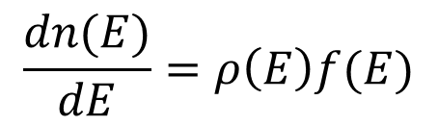
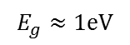
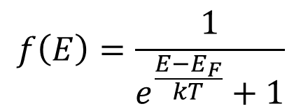
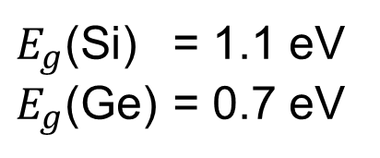
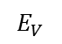
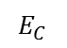
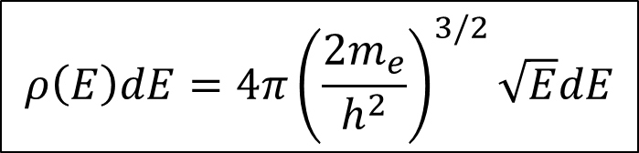
Crystals
The probability of an energy level being filled:
Electron density in the conduction band:
$$E_{C}$$
$$f\left(E\right)=\frac{1}{e^{\frac{E−E_{F}}{kT}}+1}$$
Electron energy
$$E_{g}≈\text{1}\text{eV}$$
$$E_{V}$$
Density of e⁻ states
Semiconductor
$$\frac{dn(E)}{dE}=ρ\left(E\right)f(E)$$
$E_{g}$(Si) = 1.1 eV
$E_{g}$(Ge) = 0.7 eV
$$ρ\left(E\right)dE=4π{\left(\frac{2m_{e}}{h^{2}}\right)}^{3/2}\sqrt{E}dE$$
For HW: Derive This
Notes:
Probability is from the Fermi-Dirac distribution
Homework hint: At the bottom of the conduction band, the density of states can be approximated by cubic potential well.

Slide 7
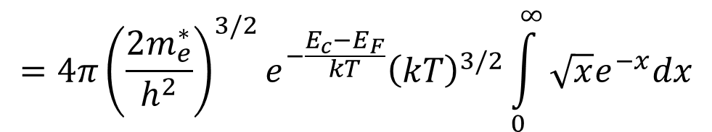
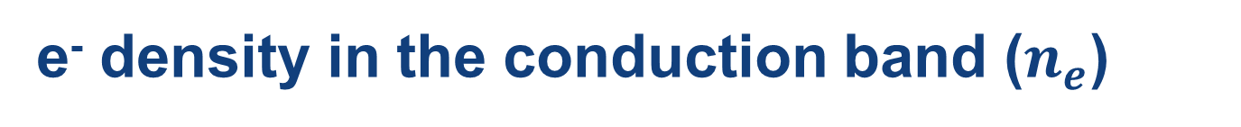
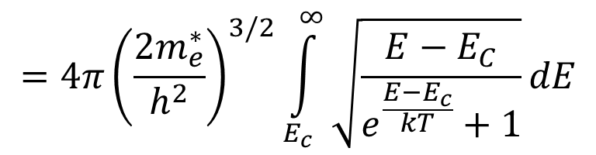
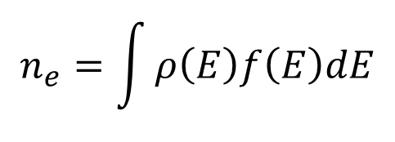
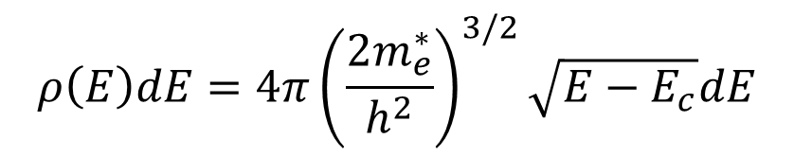
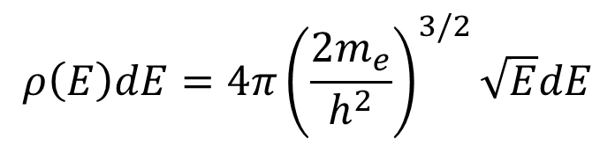
e⁻ density in the conduction band ($n_{e}$)
$$ρ\left(E\right)dE=4π{\left(\frac{2m_{e}}{h^{2}}\right)}^{3/2}\sqrt{E}dE$$
Effective mass
$$ρ\left(E\right)dE=4π{\left(\frac{2m_{e}^{∗}}{h^{2}}\right)}^{3/2}\sqrt{E−E_{c}}dE$$
$$n_{e}=\int{ρ\left(E\right)f\left(E\right)dE}$$
e⁻ density
$$=4π{\left(\frac{2m_{e}^{∗}}{h^{2}}\right)}^{3/2}\int_{E_{c}}^{∞}{\sqrt{\frac{E−E_{C}}{e^{\frac{E−E_{c}}{kT}}+1}}dE}$$
$$=4π{\left(\frac{2m_{e}^{∗}}{h^{2}}\right)}^{3/2}e^{−\frac{E_{c}−E_{F}}{kT}}{\left(kT\right)}^{3/2}\int_{0}^{∞}{\sqrt{x}e^{−x}dx}$$
Notes:
The top equation is generalized but we only want to consider the electrons near the bottom of the conduction band

Slide 8
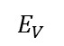
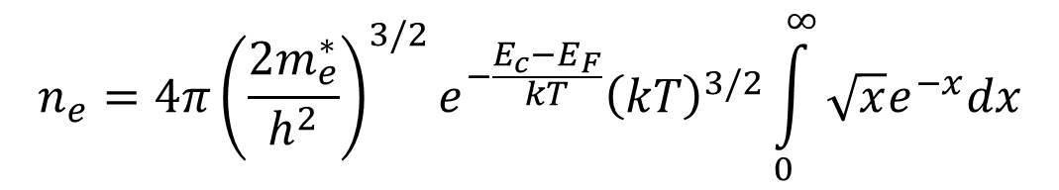
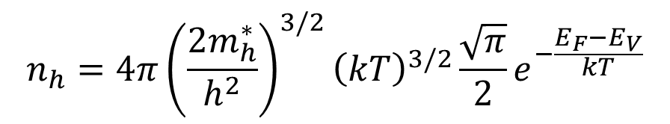
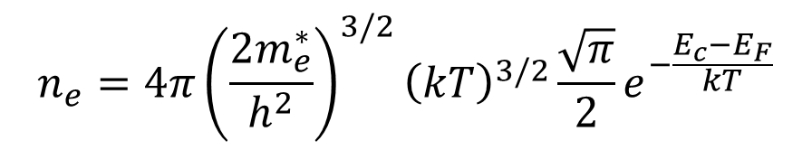
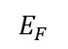
e⁻ density in the conduction band ($n_{e}$)
$$n_{e}=4π{\left(\frac{2m_{e}^{∗}}{h^{2}}\right)}^{3/2}e^{−\frac{E_{c}−E_{F}}{kT}}{\left(kT\right)}^{3/2}\int_{0}^{∞}{\sqrt{x}e^{−x}dx}$$
$$n_{e}=4π{\left(\frac{2m_{e}^{∗}}{h^{2}}\right)}^{3/2}{\left(kT\right)}^{3/2}\frac{\sqrt{π}}{2}e^{−\frac{E_{c}−E_{F}}{kT}}$$
$$n_{h}=4π{\left(\frac{2m_{h}^{∗}}{h^{2}}\right)}^{3/2}{\left(kT\right)}^{3/2}\frac{\sqrt{π}}{2}e^{−\frac{E_{F}−E_{V}}{kT}}$$
$$E_{C}$$
Electron energy
$$E_{g}≈\text{1}\text{eV}$$
Density of holes
$$E_{F}$$
$$E_{V}$$
Semiconductor

Slide 9
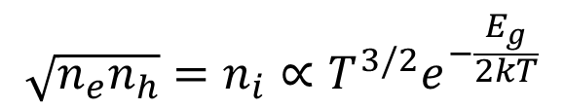
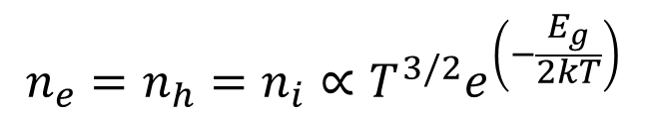
e⁻ density in the conduction band ($n_{e}$)
$$n_{e}=4π{\left(\frac{2m_{e}^{∗}}{h^{2}}\right)}^{3/2}e^{−\frac{E_{c}−E_{F}}{kT}}{\left(kT\right)}^{3/2}\int_{0}^{∞}{\sqrt{x}e^{−x}dx}$$
$$n_{e}=4π{\left(\frac{2m_{e}^{∗}}{h^{2}}\right)}^{3/2}{\left(kT\right)}^{3/2}\frac{\sqrt{π}}{2}e^{−\frac{E_{c}−E_{F}}{kT}}$$
$$n_{h}=4π{\left(\frac{2m_{h}^{∗}}{h^{2}}\right)}^{3/2}{\left(kT\right)}^{3/2}\frac{\sqrt{π}}{2}e^{−\frac{E_{F}−E_{V}}{kT}}$$
Density of holes
In a pure semiconductor:
Impure:
$$n_{e}=n_{h}=n_{i}∝T^{3/2}e^{\left(−\frac{E_{g}}{2kT}\right)}$$
Intrinsic charge carrier concentration
$$\sqrt{n_{e}n_{h}}=n_{i}∝T^{3/2}e^{−\frac{E_{g}}{2kT}}$$
Notes:
Pure semiconductor = intrinsic semiconductors

Slide 10
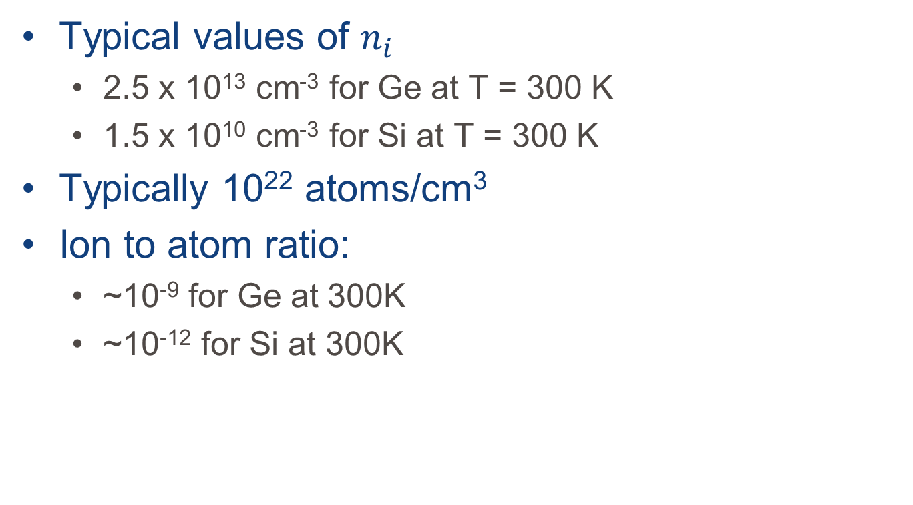
e⁻ density in the conduction band ($n_{e}$)
Typical values of $n_{i}$
2.5 x 10¹³ cm⁻³ for Ge at T = 300 K
1.5 x 10¹⁰ cm⁻³ for Si at T = 300 K
Typically 10²² atoms/cm³
Ion to atom ratio:
~10⁻⁹ for Ge at 300K
~10⁻¹² for Si at 300K

Slide 11
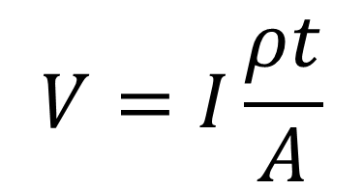
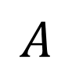
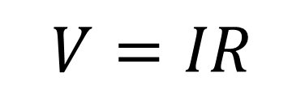
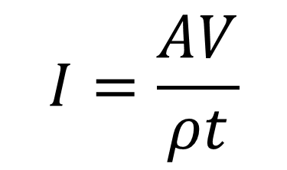
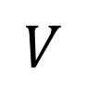

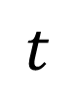
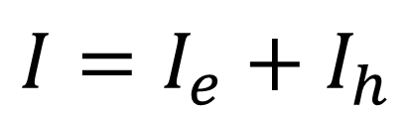
Current in a semiconductor
$$V=IR$$
$$A$$
$$V=I\frac{ρt}{A}$$
$$t$$
$$I=\frac{AV}{ρt}$$
$$∼$$
$$I=I_{e}+I_{h}$$
$$V$$

Slide 12
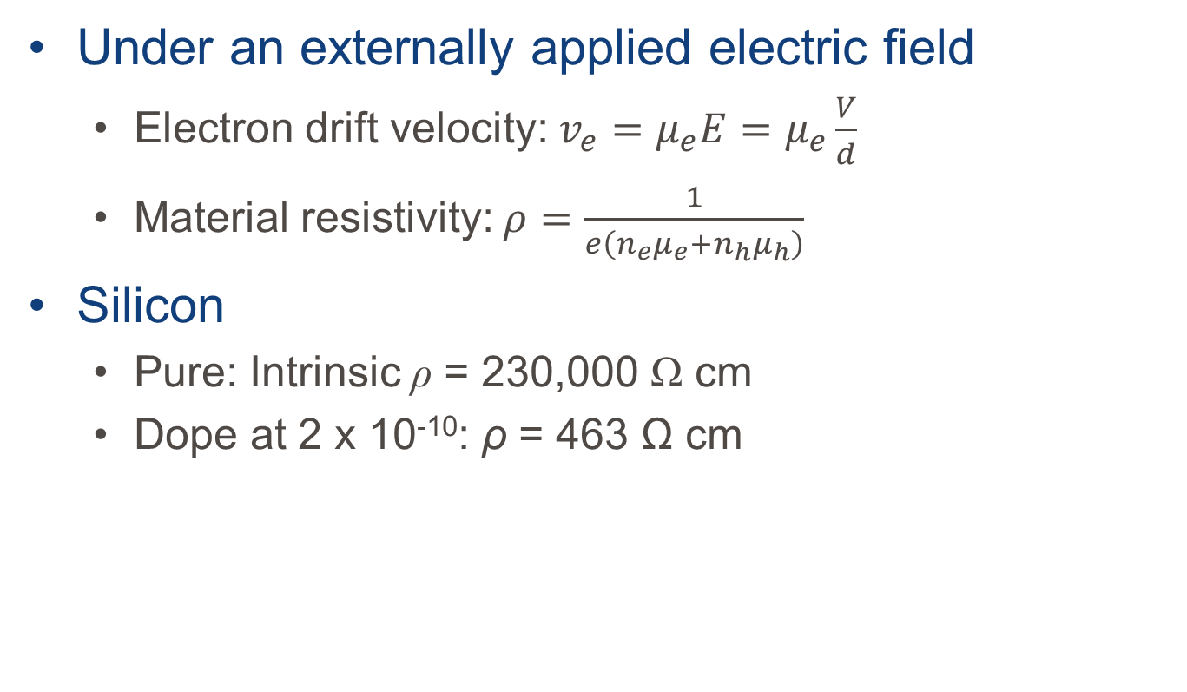
Electron mobility
Under an externally applied electric field
Electron drift velocity: $v_{e}=μ_{e}E=μ_{e}\frac{V}{d}$
Material resistivity: $ρ=\frac{1}{e\left(n_{e}μ_{e}+n_{h}μ_{h}\right)}$
Silicon
Pure: Intrinsic ρ = 230,000 Ω cm
Dope at 2 x 10⁻¹⁰: ρ = 463 Ω cm

Slide 13
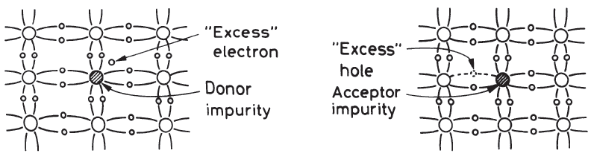
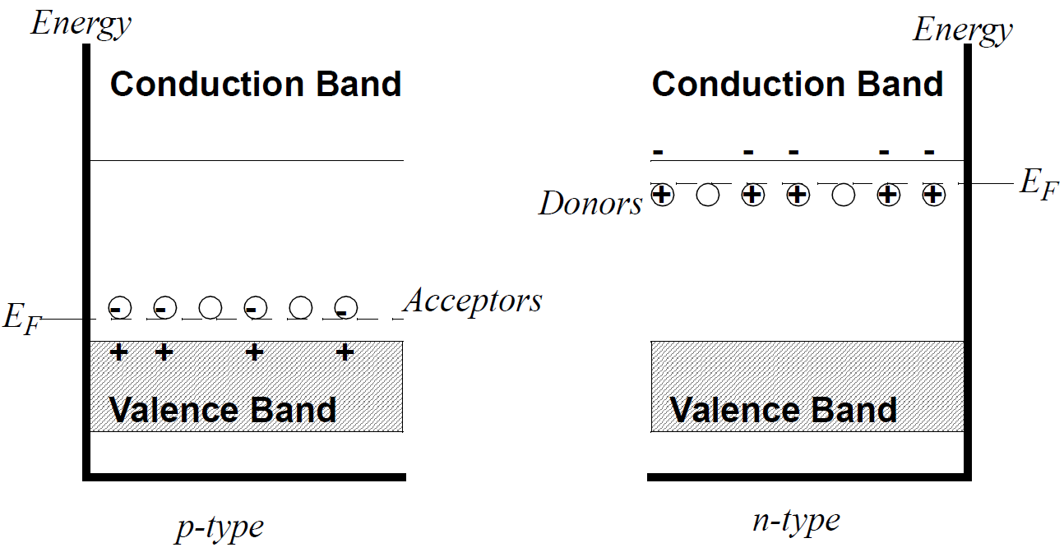
Semiconductor doping
Addition of impurities can create additional states within an energy gap.
10⁻⁷ -10⁻¹⁰ as a fractional impurity

Slide 14
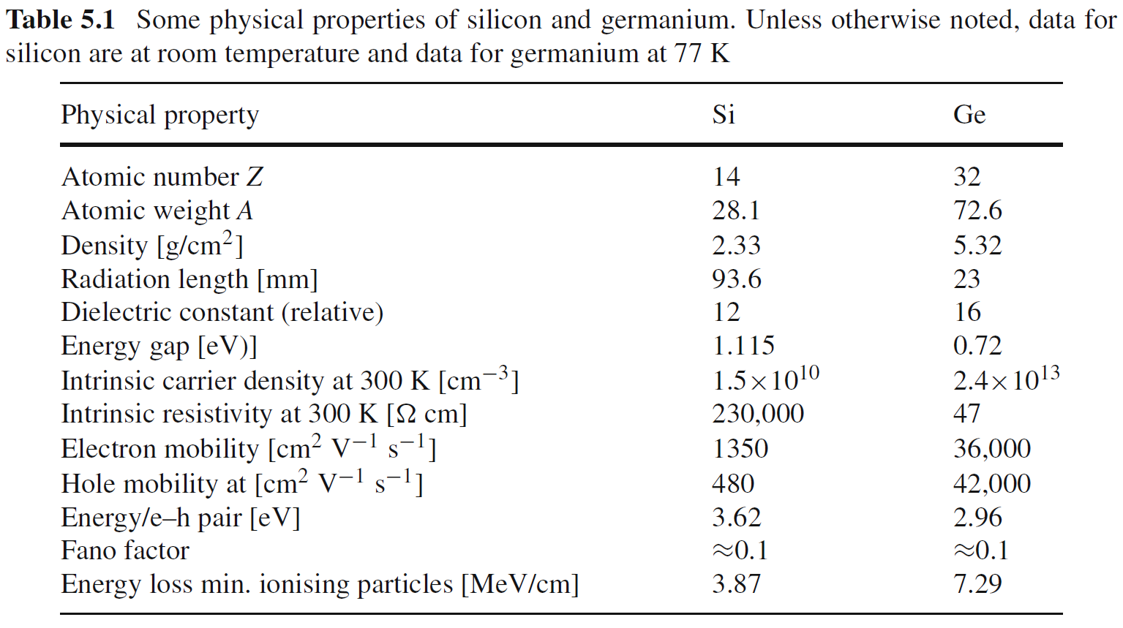
Detector material properties

Slide 15



Metal-Metal Junction
Each metal has its own $E_{f}$ and $Φ$
Both metals are neutral
If placed in contact electrons will move from A to B until the energy levels are equal
Metals become charged.
Slide courtesy of M. Fortner, N. Illinois University

Slide 16



Metal-Semiconductor junction
The two materials begin with different $E_{f}$ and $Φ$
Metal’s $E_{F}$ must be inside semi-conductor’s bandgap
Field in the semiconductor:
$$E=\frac{Nex}{ε_{r}ε_{0}}$$
Notes:
$N$ is the number density of donor atoms
$ε_{r}$ is the dielectric constant of the semiconductor
x is the distance into the semiconductor.
$ΔE_{F}$ is the energy difference between the metal’s $E_{F}$ and the semi-conductor’s band edge where the majority of the carriers reside.
For a doped n-type semiconductor, it’s the electron donor level
For a doped p-type semiconductor, it’s the hole donor level

Slide 17




Depletion
Slide courtesy of M. Fortner, N. Illinois University
Once materials in contact electrons flow semiconductor → metal
Barrier thickness:
$$V=\int{E dx}=\int{\frac{Nex}{ε_{r}ε_{0}}dx=\frac{NeD^{2}}{2ε_{r}ε_{0}}}$$
Example: Ge with 10⁻⁷ donor/atom and 1 V applied across.
$ε_{r}=16$, N = 4.4 x 10²¹ m⁻³, D = 630 nm
E = 30 kV/cm
$$D=\sqrt{\frac{2ε_{r}ε_{0}V}{Ne}}$$
Notes:
Electrons in the n-type semiconductor can lower their energy by traversing the junction
As the electrons leave the semiconductor, a positive charge, due to the ionized donor atoms, stays behind.
This charge creates a negative field and lowers the band edges of the semiconductor.
Electrons flow into the metal until equilibrium is reached between the diffusion of electrons from the semiconductor into the metal and the drift of electrons caused by the field created by the ionized impurity atoms
This equilibrium is characterized by a constant Fermi energy throughout the structure.

Slide 18
Punchline!!!!!
Interactions in the depleted region create electron-hole pairs that move in opposite directions.
However, metal-semiconductor depletion regions are small:
~630 nm
Current is constantly flowing (if no outside bias is applied)
Notes:
If, however a forward bias (+V) is applied, $E_{F}$ of the metal is lowered WRT the semiconductor,
depletion region shrinks
Field at the junction lowers
more current flows
If a reverse (-V) is applied, $E_{F}$ of the metal is raised WRT the semiconductor,
Depletion region increases
Field at junction increases
Current goes almost to zero.

Slide 19




n-p semiconductor junction - Schematic
Thermal agitation moves electrons across to holes
Soon E-field large enough to prevent movement
$E_{f}$ now the same on both sides
Charge deposited in high field region:
Moved quickly to one side
Notes:
Both side electrically neutral In n-type => Many free electrons. In p-type => many free holes.

Slide 20





n-p junction – a little rigor
$$N_{a}≫N_{d}$$
Charge density
$eN_{d}$
$−eN_{a}$
$$N_{d}x_{n}=N_{a}x_{p}$$
$$x_{n}≫x_{d}$$
Notes:
N_{a} >> N_{d} because that’s the nature of the dopant.
P-type Silicon is evaporated onto the surface of a block of n-type Silicon.
Since at the junction the charge should be zero, As a result N_{d}x_{n}=N_{a}x_{p}

Slide 21



n-p junction – a little rigor
$$\frac{d^{2}V}{x^{2}}=−\frac{ρ(x)}{ε}$$
We start out with 4 regions:
$V_{1}\left(x\right):−∞<x<−x_{p}$
$ρ=0$
$V_{2}\left(x\right):−x_{p}<x<0$
$ρ=−eN_{a}$
$V_{3}\left(x\right):0<x<x_{n}$
$ρ=eN_{d}$
$V_{4}\left(x\right):x_{n}<x<∞$
$ρ=0$
In regions 1 & 4
$$\frac{dV_{1}}{dx}=\frac{dV_{4}}{dx}=0⟹\left\{\begin{matrix}V_{1}\left(x\right)=C_{1} \\ V_{4}\left(x\right)=C_{4}\end{matrix}\right.$$

Slide 22





n-p junction – a little rigor
$$\frac{d^{2}V}{x^{2}}=−\frac{ρ(x)}{ε}$$
We start out with 4 regions:
$V_{1}\left(x\right):−∞<x<−x_{p}$
$ρ=0$
$V_{2}\left(x\right):−x_{p}<x<0$
$ρ=−eN_{a}$
$V_{3}\left(x\right):0<x<x_{n}$
$ρ=eN_{d}$
$V_{4}\left(x\right):x_{n}<x<∞$
$ρ=0$
$$\int{\frac{dV_{3}}{dx}dx}=V_{3}\left(x\right)=−\frac{eN_{d}}{ε}\frac{x^{2}}{2}+C_{3a}x+C_{3b}$$
In region 3
$${\left.\frac{dV_{3}}{dx}\right|}_{x=x_{n}}=0⟹C_{3a}=\frac{eN_{d}}{ε}x_{n}$$
$$\frac{d^{2}V_{3}}{dx^{2}}=−\frac{eN_{d}}{ε}$$
$$\int{\frac{d^{2}V_{3}}{dx^{2}}dx}=\frac{dV_{3}}{dx}=−\frac{eN_{d}}{ε}x+C_{3a}$$
Notes:
Just solve the Poisson equation

Slide 23



n-p junction – a little rigor
$$\frac{d^{2}V}{x^{2}}=−\frac{ρ(x)}{ε}$$
We start out with 4 regions:
$V_{1}\left(x\right):−∞<x<−x_{p}$
$ρ=0$
$V_{2}\left(x\right):−x_{p}<x<0$
$ρ=−eN_{a}$
$V_{3}\left(x\right):0<x<x_{n}$
$ρ=eN_{d}$
$V_{4}\left(x\right):x_{n}<x<∞$
$ρ=0$
In region 2, the same arguments get you:
$$V_{2}\left(x\right)=\frac{eN_{a}}{ε}\frac{x^{2}}{2}+\frac{eN_{a}x_{p}}{ε}x+C_{2b}$$
In region 3
$${\left.\frac{dV_{3}}{dx}\right|}_{x=x_{n}}=0⟹C_{3a}=\frac{eN_{d}}{ε}x_{n}$$
$$V_{3}\left(x\right)=−\frac{eN_{d}}{ε}\frac{x^{2}}{2}+\frac{eN_{d}x_{n}}{ε}x+C_{3b}$$
Notes:
Just solve the Poisson equation

Slide 24





n-p junction – a little rigor
$$\frac{d^{2}V}{x^{2}}=−\frac{ρ(x)}{ε}$$
$$V_{1}\left(x\right)=C_{1}$$
$$V_{2}\left(x\right)=\frac{eN_{a}}{ε}\frac{x^{2}}{2}+\frac{eN_{a}x_{p}}{ε}x+C_{2b}$$
In region 2, the same arguments get you:
@ x = 0:
$V_{2}\left(0\right)=V_{3}\left(0\right)$
$C_{2b}=C_{3b}=C_{b}$
$$V_{3}\left(x\right)=−\frac{eN_{d}}{ε}\frac{x^{2}}{2}+\frac{eN_{d}x_{n}}{ε}x+C_{3b}$$
$$V_{4}\left(x\right)=C_{4}$$
Notes:
Just solve the Poisson equation

Slide 25







n-p junction – a little rigor
$$\frac{d^{2}V}{x^{2}}=−\frac{ρ(x)}{ε}$$
$$V_{1}\left(x\right)=C_{1}$$
$$V_{2}\left(x\right)=\frac{eN_{a}}{ε}\frac{x^{2}}{2}+\frac{eN_{a}x_{p}}{ε}x+C_{b}$$
In region 2, the same arguments get you:
$$V_{3}\left(x\right)=−\frac{eN_{d}}{ε}\frac{x^{2}}{2}+\frac{eN_{d}x_{n}}{ε}x+C_{b}$$
Potential across the junction:
$$V_{0}=V_{4}−V_{1}=V_{3}\left(x_{n}\right)−V_{2}\left(−x_{p}\right)$$
$$V_{4}\left(x\right)=C_{4}$$
$$V_{0}=\frac{eN_{d}x_{n}^{2}}{2ε}+\frac{eN_{a}x_{p}^{2}}{2ε}≈\frac{eN_{d}x_{n}^{2}}{2ε}$$
$$x_{n}≫x_{d}$$
Notes:
Just solve the Poisson equation

Slide 26





What have we learned?
$$V_{0}≈\frac{eN_{d}x_{n}^{2}}{2ε}$$
We can approximate the depletion depth, D
If we want the largest D:
Increase the voltage
Decrease the dopant concentration
How low can you go?
High purity n-type Si $ρ=20$ kΩ cm
N_{d} ≈ 2.3 x 10¹¹ cm⁻³
$$x_{n}≫x_{d}$$
$$D=\sqrt{\frac{2εV_{0}}{eN_{d}}}$$
$$D≈x_{n}$$
Without bias, ~0.7V across over depletion layer
D ≈ 64 μm
With bias, breakdown @ 160 kV/cm
D ≈ 10 mm

Slide 27
Punchline 2 (semiconductor junction edition)
Interactions in the depleted region create electron-hole pairs that move in opposite directions.
However, metal-semiconductor depletion regions are small:
~630 nm
Current is constantly flowing (if no outside bias is applied)
Current only flows when charge deposited in depletion region
Energy to remove an electron:
Ar gas: 30 eV/electron-ion pair
Si: 3.6 eV/electron-hole pair @ 300 K
Homework
Up to 10 mm in Si. 10 cm in Ge
Notes:
For homework, show how you get to a 10cm depletion region.

Slide 28
General pros/cons of semiconductors
Pros:
Denser material
Lower energy for charge generation
Fast signals (~ns)
Cons
Difficult to manufacture
Hard to get large area detectors
More specialized detection schemes
No charge multiplication so electronics must be sensitive.
 | Si | Ge
300 K | 3.62 eV | ------
77 K | 3.81 eV | 2.96 eV
Notes:
Denser material means more interactions/unit length and a greater probability of complete energy deposition in a single detector
Lower energy means there are more electrons generated for the same interaction with gas
There are ways to generate charge multiplication but the risk of breakdown across the junction is huge so only very specialized operations even try this.

Slide 29
Applications
Si – Particle/Low E γ
Ge – High-E γ
10 mm max depth too small for high energy γ but perfect for α’s
Except for low energy applications, can be kept at room temp
Resolution ~10 keV
Not great for 50 keV γ’s
Fine for MeV α’s
http://dx.doi.org/10.1109/23.958703
10 cm depth better for γ’s
Small (~0.7 eV) band gap energy
Kept cold to avoid thermal noise
More pairs created
Resolution ~3 eV
Notes:
Alphas never really have enough energy to go more than a few mm deep.
Photons with 10-100 keV of energy have better interaction probability in Si
We’ll discuss resolution in Lecture 6 as part of a larger probability discussion

Slide 30


The Si strip detector
Charged particle tracking detector used in the CMS experiment. The detector consists of two wafers of silicon put side to side. Four amplifying chips with 512 amplifying channels each are visible in the top-left side of the picture. Each silicon wafer has strips as shown in Fig. 5.10, with a pitch of 180 μm. The r.m.s. spatial resolution is ≈25 μm.
Notes:
Bottom - Large Aluminum contact provides the bias across the junction
Passivation layer is to insulate the bulk Silicon from the environment.
DSSD has x-semiconductors on one side and y-semiconductors on the other side.
You would want the depletion depth for a given semiconductor to be ~half for a single sided detector

Slide 31



Germanium Detectors

